Slide 1
Staff Training in UACEG-Sofia, Bulgaria
Assoc. Prof. Dr. Eng. Petar Filkov
University of Architecture, Civil Engineering and Geodesy, Sofia, Bulgaria
Workshop on innovative practices in the EU water sector: barriers and opportunities BOKU, Vienna/ 08-10.05.2019
This project has been funded with support from the European Commission. This publication reflects the views only of the author, and the Commission cannot be held responsible for any use which may be made of the information contained therein.

Slide 2
Agenda
Reflection of the water policies in the education: insights form the Bulgarian experience
University of Architecture, Civil Engineering and Geodesy Sofia
29 – 31 MAY 2019
Strengthening of master curricula in water resources management
for the Western Balkans HEIs and stakeholders

Slide 3
Agenda
Strengthening of master curricula in water resources management
for the Western Balkans HEIs and stakeholders

Slide 4
Agenda
Strengthening of master curricula in water resources management
for the Western Balkans HEIs and stakeholders

Slide 5
Agenda
Please send names of participants in order to assure permission from “Sofiyska voda” AD to visit the WWTP!
The WWTP is an object of national importance and access is granted by respective authorities.
Strengthening of master curricula in water resources management
for the Western Balkans HEIs and stakeholders

Slide 6
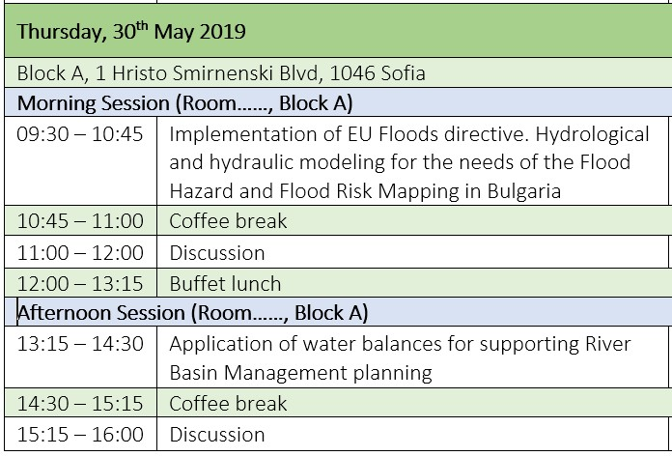
Agenda
On 30th and 31st of May (Thursday and Friday) there will be Bulgarian-Austrian Seminar “Hydrological Hazards and Related Problems”
Is it appropriate to “accommodate” part of the training into the Seminar?
Strengthening of master curricula in water resources management
for the Western Balkans HEIs and stakeholders

Slide 7
UACEG Location
Strengthening of master curricula in water resources management
for the Western Balkans HEIs and stakeholders

Slide 8
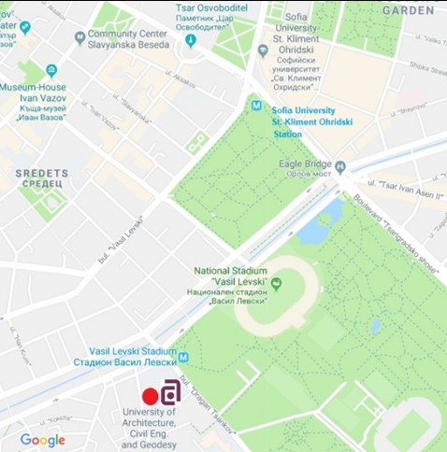
UACEG Location
The post address is 1046 Sofia, 1 Hristo Smirnenski Blvd
The university has good connection to
Sofia Airport (via Metro)
The Metro Station “Vasil Levski Stadium” is at some 50 m distance from the Rectorate building of UACEG.
Sofia Central Railway Station and International Bus Station (via Metro and tram).
Strengthening of master curricula in water resources management
for the Western Balkans HEIs and stakeholders

Slide 9
UACEG Location
Rectorate Building
Block B
New Building Entrance
Block A
Strengthening of master curricula in water resources management
for the Western Balkans HEIs and stakeholders

Slide 10
Invitation
On 7th and 8th of November (Thursday and Friday) there will be
International Jubilee Conference: Science & Technic
on the occasion of 70th anniversary of the
Faculty of Hydraulic Engineering
Conference website: http://70years-fhe.uacg.bg
Deadline for submitting abstracts: 15th of September
Strengthening of master curricula in water resources management
for the Western Balkans HEIs and stakeholders

Slide 11
THANK YOU FOR YOUR ATTENTION!
Strengthening of master curricula in water resources management
for the Western Balkans HEIs and stakeholders

